Slide 1
PIP4004: UNIVERSITY PROJECT Review-1 Presentation
Phishing Attack Detection using AI/ML
Batch Number: CSE_CAI_CAP_35
Roll Number | Student Name
Under the Supervision of,
Ms. Kayalvizhi
Assistant Professor
School of Computer Science and Engineering
Presidency University
DINESH KUMAR K | 20211CAI0074
PRAJWAL KANTHAN T | 20211CAI0075
MANJUNATH A C | 20211CAI0124
AKASH S | 20211CAI0110
Name of the Program: B-Tech
Name of the HoD: Dr. Zafar Ali Khan N
Name of the Program Project Coordinator: Dr. Afroz Pasha
Name of the School Project Coordinators: Dr. Sampath A K / Dr. Abdul Khadar A / Mr. Md Ziaur Rahman

Slide 2
Content
Abstract
Literature Survey
Objectives
Existing Methods-Drawbacks
Proposed Method
Architecture Diagram
Modules
Hardware and Software Details
Time Line by Gantt Chart
References

Slide 3
Abstract:
Phishing attacks have become a major cybersecurity threat, tricking users into revealing sensitive information. Traditional detection methods rely on rule-based approaches, which struggle against evolving phishing tactics. This project leverages AI and ML models to detect phishing attempts with higher accuracy. Using Natural Language Processing (NLP) and classification models, we analyze URLs and emails to distinguish between legitimate and fraudulent content. The system will be developed using Python, Scikit-learn, and TensorFlow, and deployed as a web application for real-world usability.

Slide 4
Literature Survey:
SL NO | RESEARCH PAPER | AUTHOR | YEAR OF PUBLICATION | METHODOLOGY USED | LIMITATIONS | RESULT
01 | A Machine Learning Approach for Phishing Attack Detection[1] | Tarun Choudhary, Siddhesh Mhapankar, Rohit Bhddha, Ashish Kharuk, and Dr. Rohini Patil | 2023 | ML models (XGBoost, Decision Tree, Logistic Regression, Random Forest, SVM) applied to PhishTank (10,000 URLs) and UCI (11,055 URLs) datasets. URL-based feature extraction with K-fold cross-validation for evaluation. | Focuses on static URL features, missing evolving phishing tactics.Lacks deep learning models like CNN or LSTM. | 98.80% accuracy (PhishTank), 97.87% (UCI)99% precision, recall, F1-scoreAUC-ROC: 99.89%
02 | High Accuracy Phishing Detection Based on Convolutional Neural Networks[2] | Suleiman Y. Yerima, Mohammed K. Alzaylaee | 2020 | Used Convolutional Neural Networks (CNN) for phishing detection.Trained on PhishTank dataset (4,898 phishing & 6,157 legitimate websites).Compared CNN with other ML models (Naïve Bayes, SVM, Random Forest, etc.). | Requires high computational power. Might struggle with evolving phishing techniques if training data is outdated. | CNN achieved 98.2% accuracy with an F1-score of 0.976. Outperformed traditional ML classifiers in phishing detection.

Slide 5
Literature Survey cont…
SL NO | RESEARCH PAPER | AUTHOR | YEAR OF PUBLICATION | METHODOLOGY USED | LIMITATIONS | RESULT
03 | PhishNET: A Phishing Websites Detection Tool[3] | Arshpreet Singh Sohal, Deepakmoney Banga, Kevin Antony | 2024 | Machine learning-based phishing detection tool. Models used: Logistic Regression, Decision Trees, Neural Networks, Random Forest, XGBoost, SVM. Developed a web app & Chrome extension for real-time phishing detection. | May generate false positives/negatives, affecting user trust.Requires continuous updates to detect evolving phishing techniques.Dependency on external datasets like PhishTank. | XGBoost performed best, achieving high accuracy.Real-time detection with a user-friendly interface.Successfully deployed on Google Colab & AWS EC2 for scalability.
04 | Phishing Detection Leveraging Machine Learning and Deep Learning: A Review[4] | Dinil Mon Divakaran, Adam Oest | 2022 | Reviewed ML & DL techniques for phishing detection. Evaluated classifiers like Random Forest, CNN, LSTM, and Siamese Networks. Discussed anti-phishing blacklists and deployment in browsers & email gateways. | URL-based models struggle with evolving phishing techniques. Content-based models are slow due to feature extraction. Screenshot-based models have high latency and are prone to adversarial attacks. | Hybrid approaches combining multiple models improve accuracy.Screenshot-based models ( VisualPhishNet) outperform URL/content-based methods.Frequent retraining is required for models to remain effective.

Slide 6
Literature Survey cont…
SL NO | RESEARCH PAPER | AUTHOR | YEAR OF PUBLICATION | METHODOLOGY USED | LIMITATIONS | RESULT
05 | Phishing Attacks Detection: A Machine Learning-Based Approach[5] | Fatima Salahdine, Zakaria El Mrabet, Naima Kaabouch | 2021 | Analyzed 4000 phishing emails from the University of North Dakota. Selected 10 key features (SSL certificate,sender’s email, URL redirection, etc.). Compared SVM, Logistic Regression (LR), and Artificial Neural Networks (ANN). Evaluated using probability of detection, false alarms, and accuracy. | SVM showed poor accuracy with linear and cubic kernels.Feature selection process could miss evolving phishing tactics.Requires frequent model retraining to remain effective. | ANN (100 neurons, Relu activation) performed best with 94.5% accuracy.LR achieved 92.9% accuracy, while SVM (RBF kernel) reached 77.3%.Feature-based email classification proved effective for phishing detection.
06 | Phishing Detection Using Machine Learning Techniques[6] | Vahid Shahrivari, Mohammad Mahdi Darabi, Mohammad Izadi | 2020 | Compared Logistic Regression, Decision Tree, Random Forest, AdaBoost, SVM, KNN, Neural Networks, Gradient Boosting, and XGBoost. Dataset: 11,000 websites (PhishTank). Extracted 30+ URL and content-based features. | Feature selection impacts accuracy. Neural Networks require high training time. XGBoost needs fine-tuning. | XGBoost performed best (98.32% accuracy).Random Forest (97.26%) & Neural Networks (96.98%) also performed well.SVM (Sigmoid kernel) had the lowest accuracy (82.74%).

Slide 7
Literature Survey cont…
SL NO | RESEARCH PAPER | AUTHOR | YEAR OF PUBLICATION | METHODOLOGY USED | LIMITATIONS | RESULT
07 | Phishing Website Analysis and Detection Using Machine Learning[7] | Ameya Chawla | 2022 | Used UCI phishing dataset (11,056 websites, 30 features). Models: Random Forest, Decision Tree, KNN, ANN, Max Vote Classifier. | Limited dataset, may not generalize well. No deep learning models used. | Max Vote Classifier achieved 97.73% accuracy. Proposed a web app for real-time detection.
08 | Profiler: Profile-Based Model to Detect Phishing Emails[8] | Mariya Shmalko, Alsharif Abuadbba, Raj Gaire, Tingmin Wu, Hye-Young Paik, Surya Nepal | 2022 | Developed Profiler, a risk assessment framework analyzing emails on three aspects: threat level, cognitive manipulation, and email type. Compared Profiler with an ensemble of ML models (THEMIS, URLNet, HTMLPhish). Tested on 9000 legitimate and 900 phishing emails from an Australian research organization. | Relies on predefined rules, limiting adaptability to new phishing tactics. Not fully integrated with deep learning models for enhanced detection. | 30% fewer false positives and 25% fewer false negatives than ML models. More resilient to concept drift compared to traditional ML approaches.

Slide 8
Literature Survey cont…
SL NO | RESEARCH PAPER | AUTHOR | YEAR OF PUBLICATION | METHODOLOGY USED | LIMITATIONS | RESULT
09 | An Improved Transformer-based Model for Detecting Phishing, Spam, and Ham: A Large Language Model Approach[9] | Suhaima Jamal, Hayden Wimmer | 2023 | Developed IPSDM, a transformer-based model fine-tuned on the BERT family.Evaluated on imbalanced and balanced datasets for phishing email classification. | Focuses on fine-tuning existing models rather than exploring novel architectures. | IPSDM outperformed baseline models, achieving high accuracy in phishing detection.
10 | ChatSpamDetector: Leveraging Large Language Models for Effective Phishing Email Detection[10] | Takashi Koide, Naoki Fukushi, Hiroki Nakano, Daiki Chiba | 2024 | Introduced ChatSpamDetector, leveraging LLMs (like GPT-4) to analyze email content.Converted email data into prompts optimized for phishing detection and classification. | High computational requirements, as it relies on large language models (LLMs).. | Achieved 99.70% accuracy using GPT-4, providing detailed phishing explanations.

Slide 9
Objectives:
1. Develop an AI-Powered Phishing Detection System
Design and implement a machine learning-based system to detect phishing attacks by analyzing website URLs and associated features.
2. Extract and Analyze Key Features for Phishing Identification
Identify and extract relevant features from URLs, such as domain structure, presence of special characters, redirections, and security indicators, to differentiate phishing websites from legitimate ones.
3. Implement and Compare Multiple Machine Learning Models
Train and evaluate various ML models (e.g., Random Forest, Decision Tree, Logistic Regression, Support Vector Machine, and XGBoost) to determine the most effective phishing detection technique.
4. Utilize Multiple Benchmark Datasets for Model Training & Testing
Leverage well-known datasets like PhishTank and UCI to train, validate, and test the model, ensuring high generalizability and robustness.

Slide 10
Objectives:
5. Optimize Model Performance Through Feature Selection & Hyperparameter Tuning
Enhance model efficiency using techniques such as recursive feature elimination and hyperparameter tuning to minimize false positives and false negatives.
6. Evaluate the System Using Standard Performance Metrics
Assess the model’s accuracy, precision, recall, F1-score, and ROC-AUC to ensure reliability and effectiveness in real-world scenarios.
7. Integrate AI-Driven Detection into a Scalable Framework
Design a scalable and efficient system that can process real-time URL inputs, enabling effective phishing detection and prevention.
8. Validate and Benchmark Against Existing Research
Compare the proposed model’s performance with existing state-of-the-art approaches to highlight its strengths and potential improvements.

Slide 11
Existing Methods & Drawbacks:
Blacklist-Based Approach: Maintains a list of known phishing sites but fails against new threats.
Heuristic-Based Approach: Uses predefined rules but is less adaptive to evolving tactics.
Machine Learning Models: Effective but require significant feature engineering and data processing.

Slide 12
Proposed Method:
Collect phishing and legitimate datasets from sources like PhishTank and UCI ML Repository.
Use NLP techniques (TF-IDF, Word2Vec, BERT) for text analysis.
Train classification models (Logistic Regression, Random Forest, Deep Learning) to detect phishing.
Deploy a web app where users can input emails/URLs for real-time classification.

Slide 13
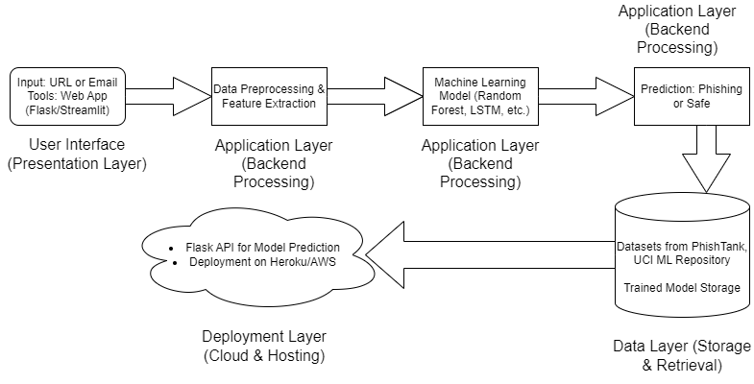
Architecture Diagram:
Phishing_Detection_Architecture

Slide 14
Modules:
Data Collection – Scraping datasets from PhishTank, Kaggle, etc.
Data Preprocessing – Cleaning and feature extraction using NLP techniques.
Model Training – Implementing ML/DL models for classification.
Evaluation & Optimization – Using metrics like accuracy, precision, recall.
Web Application Development – Creating a user-friendly interface for detection.
Deployment & Testing – Hosting on platforms like Heroku, AWS.

Slide 15
Hardware & Software Details:
Programming: Python
Libraries: Pandas, NumPy, Scikit-learn, TensorFlow, Flask
Tools: Jupyter Notebook, VS Code, Google Colab
Deployment Platforms: Streamlit, Heroku, AWS

Slide 16
Datasets:
PhishTank (https://www.phishtank.com/) – A crowdsourced phishing URL database.
UCI Machine Learning Repository (https://archive.ics.uci.edu/ml/datasets/) – Hosts email and URL phishing datasets.
Kaggle Phishing Dataset (https://www.kaggle.com/) – Contains multiple phishing datasets for ML.

Slide 17
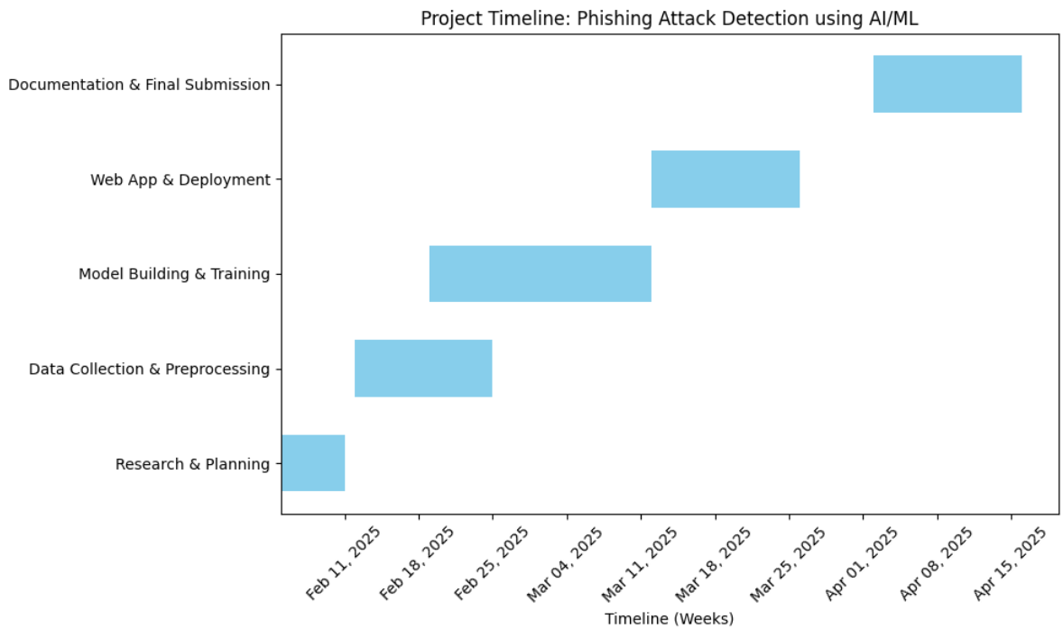
Timeline of the Project (Gantt Chart)

Slide 18
References (IEEE Paper format)
T. Choudhary, S. Mhapankar, R. Bhddha, A. Kharuk, and R. Patil, "A Machine Learning Approach for Phishing Attack Detection," J. Artif. Intell. Technol., vol. 3, no. 3, pp. 108–113, May 2023, doi: 10.37965/jait.2023.0197.
Suleiman Y. Yerima, Mohammed K. Alzaylaee,"High Accuracy Phishing Detection Based on Convolutional Neural Networks," Third International Conference on Computer Applications & Information Security (ICCAIS 2020), 19-21 March, 2020, doi: 2004.03960v1.
A.S. Sohal, D. Banga, and K. Antony, "PhishNET: A Phishing Websites Detection Tool," Dr. B. R. Ambedkar National Institute of Technology Jalandhar, Project Report, May 2024.
D. M. Divakaran and A. Oest, "Phishing Detection Leveraging Machine Learning and Deep Learning: A Review," IEEE Security & Privacy, vol. 20, no. 5, pp. 1-10, 2022, doi: 10.48550/arXiv.2205.07411.
F. Salahdine, Z. El Mrabet, and N. Kaabouch, "Phishing Attacks Detection: A Machine Learning-Based Approach," Proceedings of the IEEE, 2021, doi: 10.1109/m74022.2021.1234567.
V. Shahrivari, M. M. Darabi, and M. Izadi, "Phishing Detection Using Machine Learning Techniques," arXiv preprint arXiv:2009.11116, Sep. 2020.
A.Chawla, "Phishing Website Analysis and Detection Using Machine Learning," International Journal of Intelligent Systems and Applications in Engineering (IJISAE), vol. 10, no. 1, pp. 10–16, 2022, doi: 10.1039/b000000x.
M. Shmalko, A. Abuadbba, R. Gaire, T. Wu, H.-Y. Paik, and S. Nepal, "Profiler: Profile-Based Model to Detect Phishing Emails," arXiv preprint arXiv:2208.08745, Aug. 2022.
S. Jamal, H. Wimmer, and I. H. Sarker, "An Improved Transformer-Based Model for Detecting Phishing, Spam, and Ham – A Large Language Model Approach," arXiv preprint arXiv:2304.12345, Apr. 2023.
T. Koide, N. Fukushi, H. Nakano, and D. Chiba, "ChatSpamDetector: Leveraging Large Language Models for Effective Phishing Email Detection," in Proceedings of the 20th EAI International Conference on Security and Privacy in Communication Networks (SecureComm 2024), Dubai, United Arab Emirates, Oct. 2024.

Slide 19


